Slide 1
Diversity Study
Montgomery County Govt.
By
Sonali J

Slide 2
Underlying Questions
Does Montgomery County Government Represent Diversity?
Generations
Genders
Ethnicity
Management Category
Age

Slide 3
Little Background
Data used :
Montgomery County Government Personnel Review
Last Updated: April 18th, 2019
Montgomery County Census 2017
Last Updated year 2017
Data Source:
https://data.montgomerycountymd.gov/
https://datausa.io/profile/geo/montgomery-county-md/#demographics

Slide 4
What is Diversity?
“The condition of having or being composed of differing elements: VARIETY
especially : the inclusion of different types of people (such as people of different races or cultures) in a group or organization.” by Merriam Webster
Examples:
Gender, Age, Ethnicity, Generations etc.

Slide 6
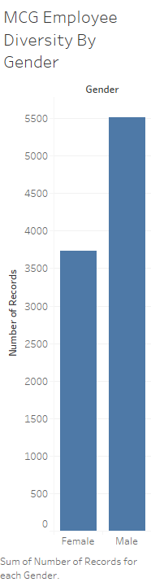
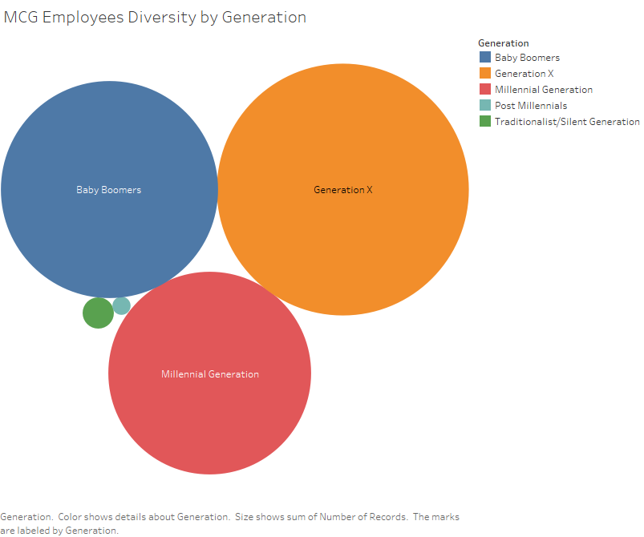

Slide 7
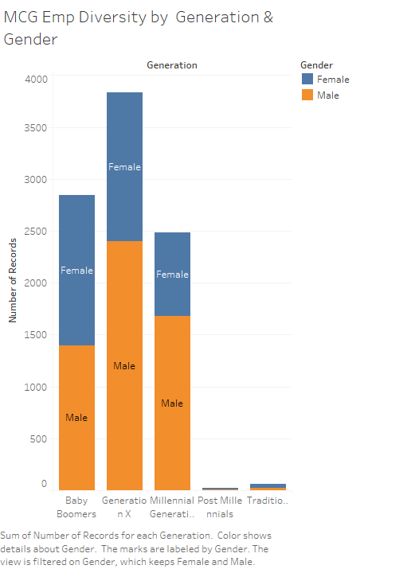

Slide 8
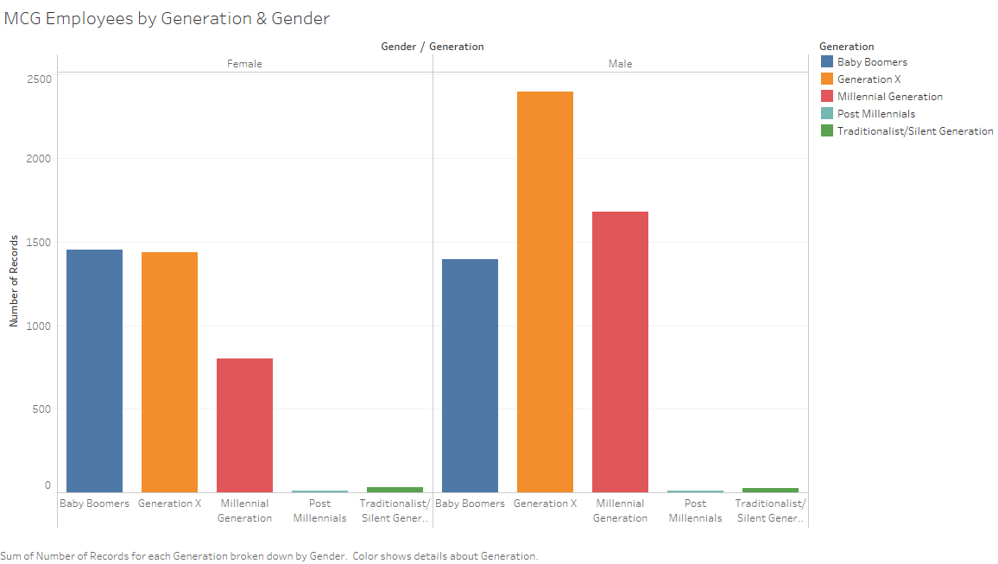

Slide 10
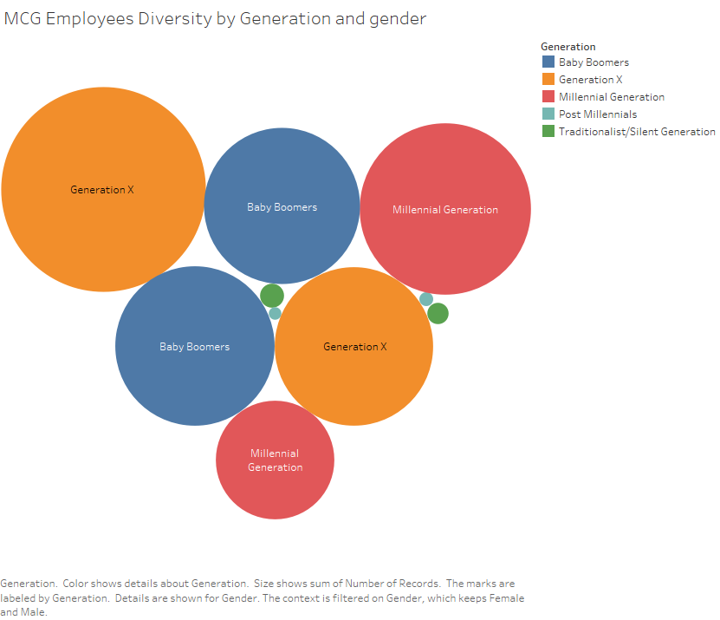

Slide 11


Slide 12
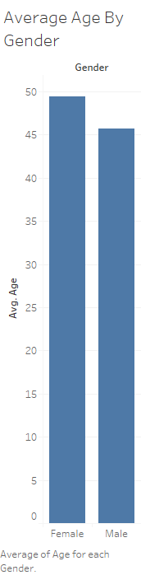

Slide 13
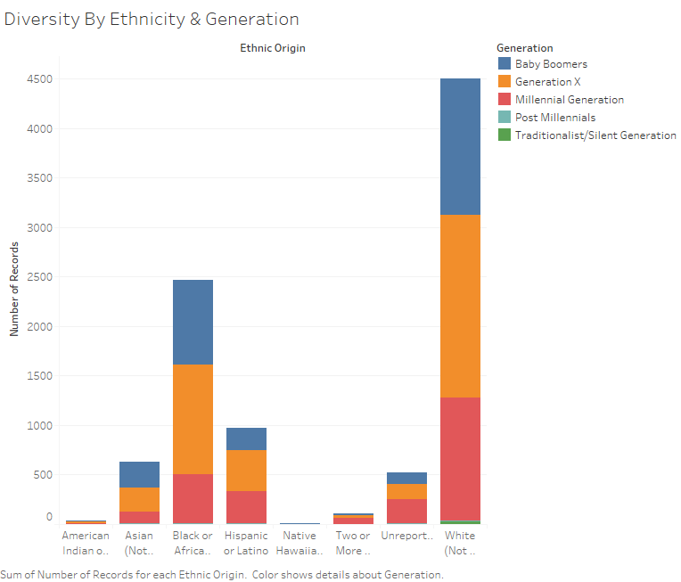

Slide 14
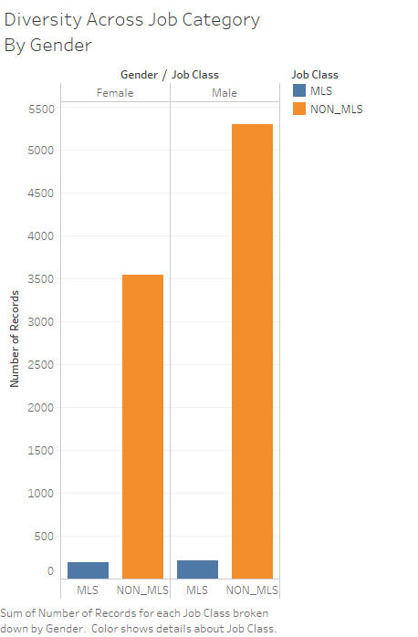

Slide 15
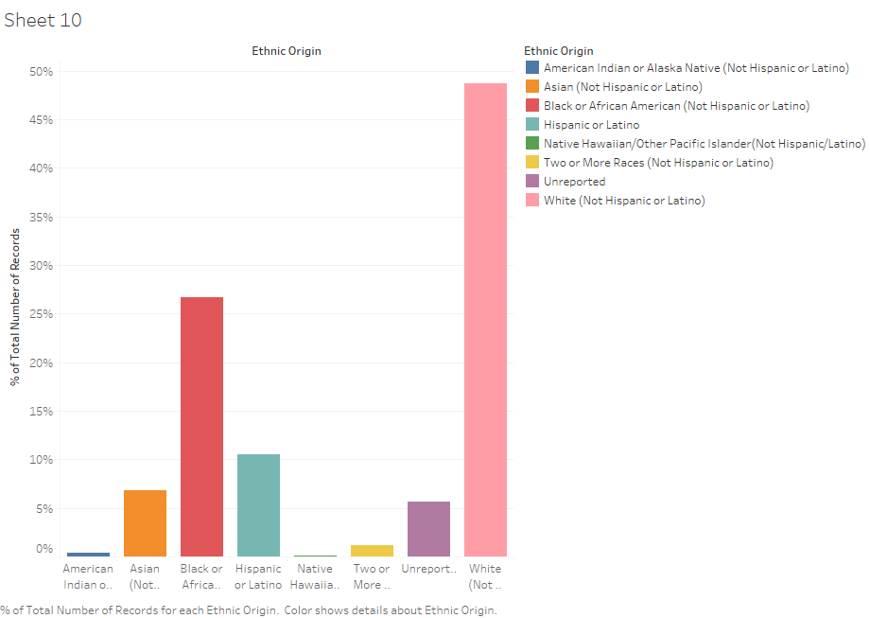

Slide 16
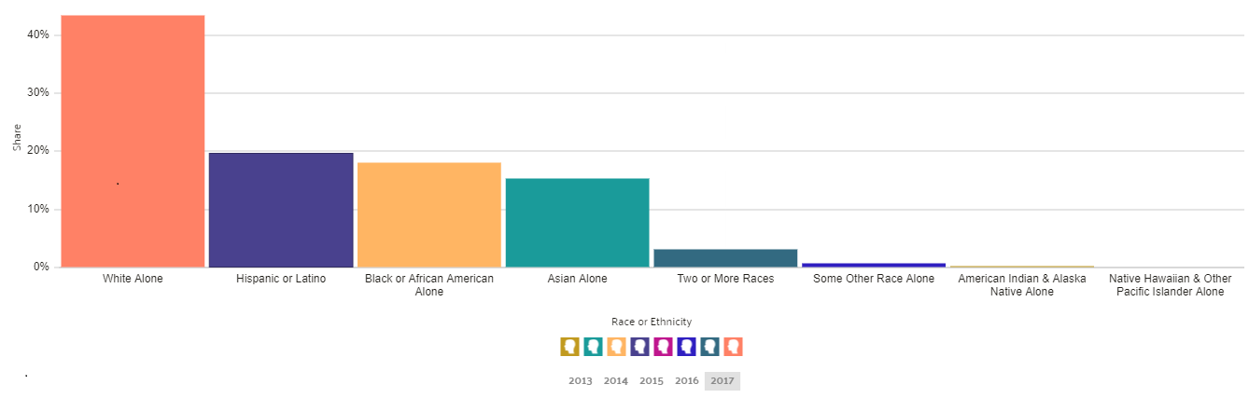
Montgomery County Diversity

Slide 17
